Slide 1


IBM ACE Training
IBM Integration Bus 10 Training
IBM Integration Bus 10 - System Administration

Slide 2


IBM Integration Bus Training
Unit objectives
After completing this unit, you should be able to:
History of Broker
Cast Iron History
Cast Iron live History
Key Integration – IBM App Connect & IBM API Connect
Callable Flows and Hybrid Integration
Road Map of IBM ACE
Difference from the previous Integration Bus v10
Forms of IBM ACE
IBM App Connect Enterprise architecture
IBM ACE agile integration (AIA)

Slide 3
IBM Integration Bus Training
History of Broker
– 1999 MQ Series Integrator (MQSI) version 1.0
– 2000 MQ Series Integrator (MQSI) version 2.0
– 2001 WebSphere MQ Integrator (WMI) version 2.1
– 2005 WebSphere Business Integration Message Broker (WBIMB) v 5.1
– 2007 WebSphere Message Broker (WMB) version 6.0
– 2009 WebSphere Message Broker (WMB) version 7.0
– 2011 WebSphere Message Broker (WMB) version 8.0
– 2013 IBM Integration Bus (IIB) version 9s
– 2015 IBM Integration Bus (IIB) version 10
– 2018 Application Connect Enterprise version 11

Slide 4
IBM Integration Bus Training
CastIron (On Premise) History
2001 Cast Iron Systems is born
2010 IBM acquired CastIron System
2010 IBM WebSphere CastIron is introduced
Deployed on DataPower Physical (WebSphere DataPower Cast Iron Appliance XH40)
Deployed on DataPower Virtual (WebSphere Cast Iron Hypervisor Edition)
Deployed on SaaS. (IBM Cast Iron Cloud)
2015 IBM WebSphere Cast Iron integration. (studio, live)
2016 rebranded as IBM App Connect Studio
2017 rebranded IBM App Connect Professional
2018 new features

Slide 5
IBM Integration Bus Training
Cast Iron Live History
2001- 2015 see previous slide
2016 IBM WebSphere Cast Iron Live dies and IBM App Connect Professional on Cloud is born (total rebuild)
2018 IBM App Connect Professional on Cloud merges with IIB to become IBM App Connect Enterprise
2018 IBM App Connect Professional is still available as a separate product

Slide 6
IBM Integration Bus Training
App Connect Integration

Slide 7
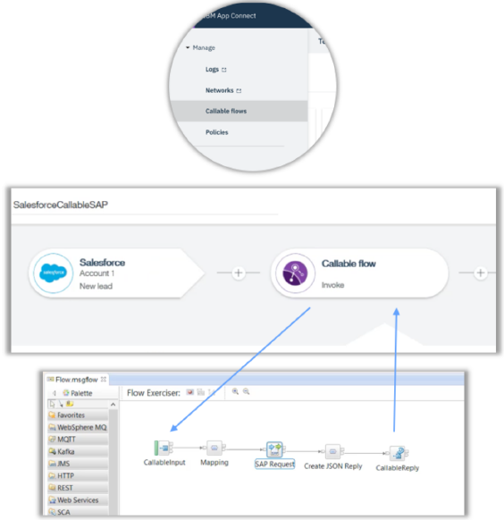
IBM Integration Bus Training
Creating truly hybrid integration
Callable flows - ability for a flow to call another flow directly, these flows can be running in cloud or locally
• Designer can call toolkit message flows and vice- versa
• Designer has native access to callable flows in UI
Why use callable flow?
• Create Hybrid flows:
o run and manage your integrations efficiently
o Split labor-intensive/complex flows
Security:
• Control who has access to what
Re-usability:
• A callable flow can be invoked by multiple different flows
Speeds interaction between IT and other
users Maintain security practices
Integrations remain unchanged

Slide 8
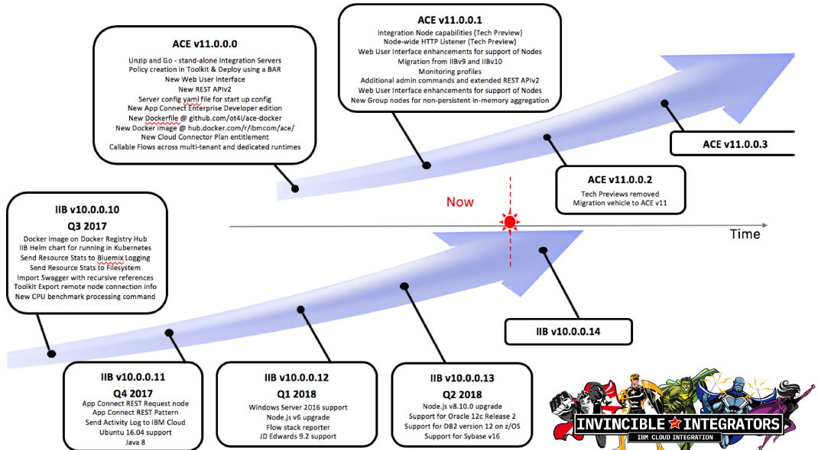
IBM Integration Bus Training
IBM IIB - Broker ROADMAP

Slide 9
IBM Integration Bus Training
Forms of IBM ACE 11.x
 ACE/IIB on IBM Cloud
 ACE/IIB on prem – Server/Virtual
 ACE/IIB on ICP
 ACE/IIB in Docker

Slide 10
IBM Integration Bus Training
ACE on IBM Cloud
Purchase App Connect Enterprise V11 FP 2
get App Connect Designer
get App Connect Toolkit
Limited to the number of VPC/PVU’s you purchase.
ACE v11.0.0.0 had the same functionality as IIB on Cloud, with
the addition of App Connect Designer.
ACE v11.0.0.1 has introduced the Node as a tech preview
ACE v11.0.0.2 has made the Node usable in a production
environment
IIB 10 to ACE 11 = 1:1 license
App Connect Enterprise V10 (aka designer) is an uplift to ACE
V11

Slide 11
IBM Integration Bus Training
IBM ACE on prem – Server/Virtual
Purchase App Connect Enterprise V11
• get App Connect Designer
• get App Connect Toolkit
• get entitlement to MQ advanced
NOTE: App Connect Pro and MQ can only be used with ACEv11. IF either product is used without going through ACEv11, then PVUs must be purchased
Limited to the number of PVU’s you purchase.
There are no plans, at this time, for ACE to become a CD release product. It will stay a LTS (long Term Support) product
IIB 10 to ACE 11 = 1:1 license
App Connect Enterprise V10 (aka designer) is an uplift to ACE V11

Slide 12
IBM Integration Bus Training
IBM IIB/ACE on Private CLoud
Purchase App Connect Enterprise V11
get App Connect Designer
get App Connect Toolkit
get entitlement to MQ advanced
Limited to the number of PVU’s you purchase.
ACE for containers comes with sample helm charts, and ACE in a Docker container, ready to deploy.
NOTE: This is the developer edition of the software. You will need to use your
own licensed version of the software.
IIB 10 to ACE 11 = 1:1 license App Connect Enterprise V10 (aka designer) is an uplift to ACE V11

Slide 13
IBM Integration Bus Training
IBM ACE on Docker
Purchase App Connect Enterprise V11
get entitlement to App Connect Designer
get entitlement to MQ standard
Limited to the number of PVU’s you purchase.
This is the same download as ACE On IBM Cloud Private. In
Passport Advantage it is call ACE in Containers.
IIB 10 to ACE 11 = 1:1 license
App Connect Enterprise V10 (aka designer) is an uplift to ACE
V11

Slide 14
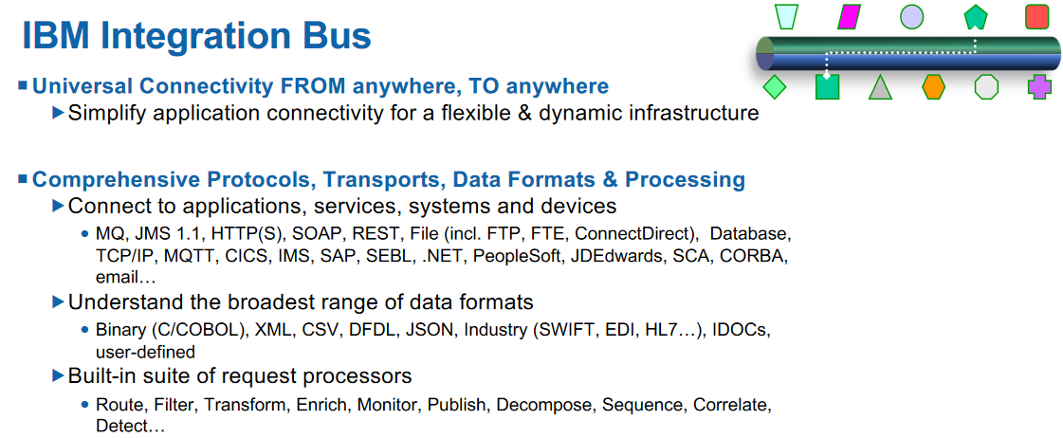
IBM Integration Bus Training
IBM App Connect Enterprise & IBM Integration Bus

Slide 15
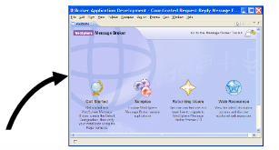
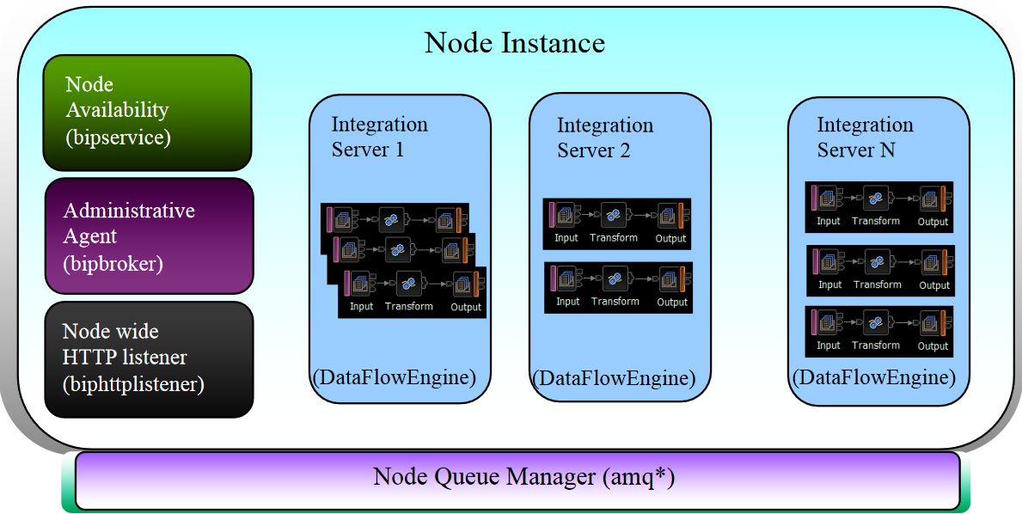
IBM Integration Bus Training
IBM Integration Bus architecture
Web Admin Console

Slide 16
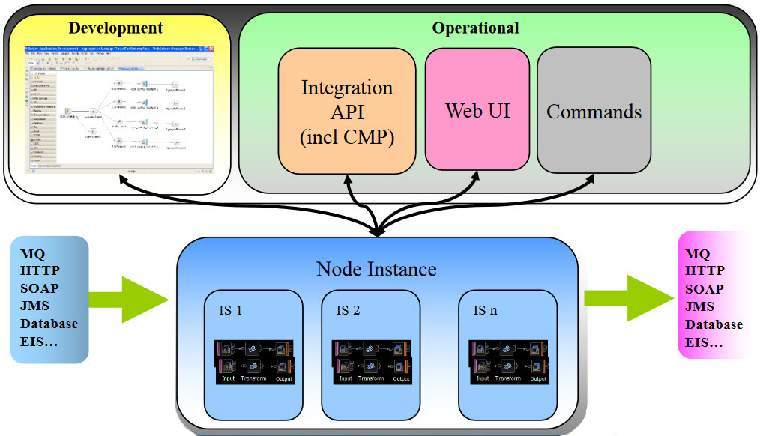
IBM Integration Bus Training
Node Instance – Development and Operations

Slide 17
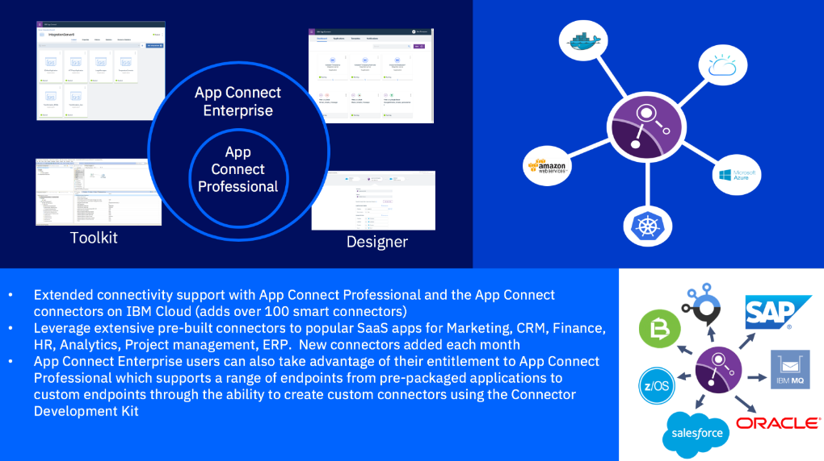
IBM Integration Bus Training
IBM App Connect Enterprise on Cloud

Slide 18
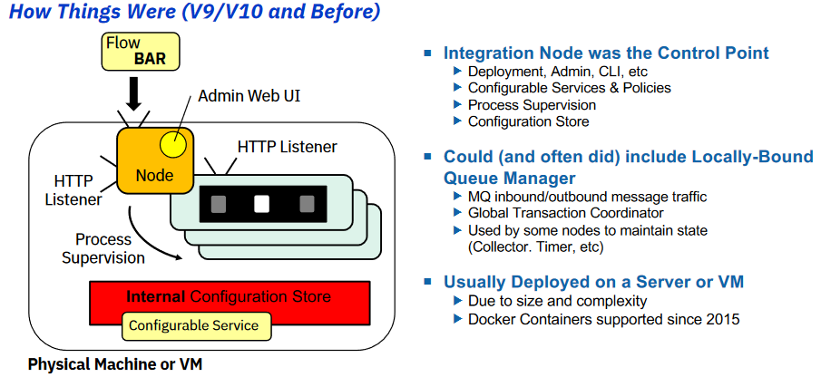
IBM Integration Bus Training
Previous Versions – How and What

Slide 19
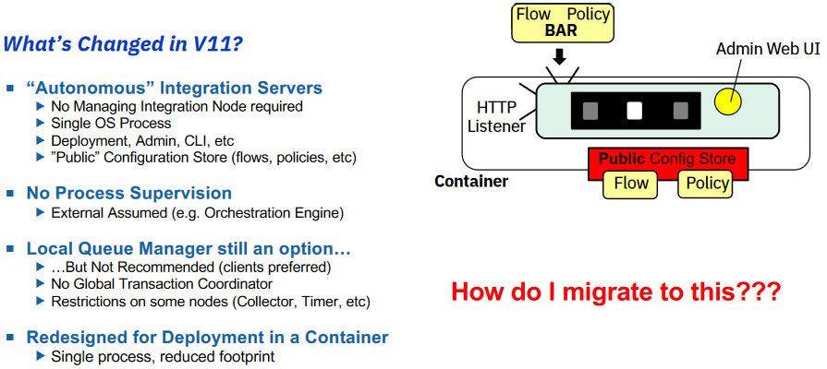
IBM Integration Bus Training
Changes in V11

Slide 20
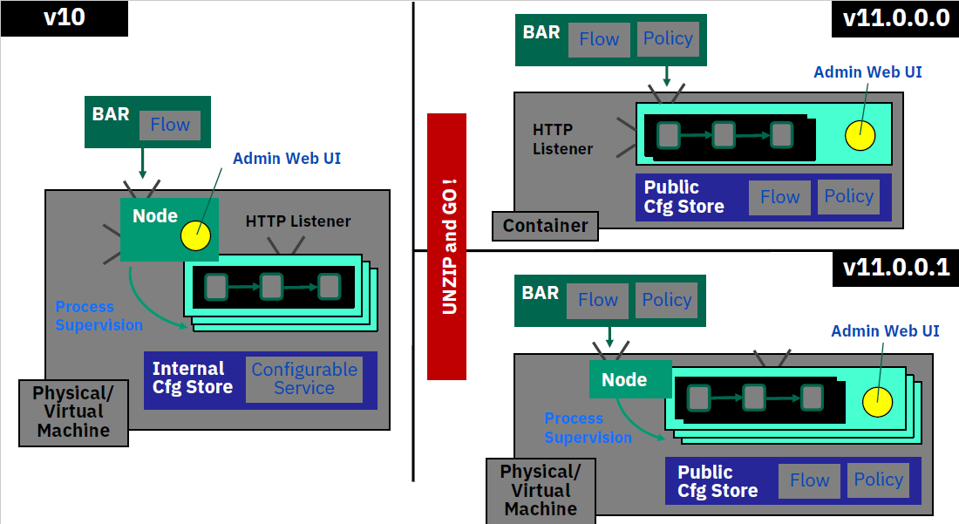
IBM Integration Bus Training
Difference from the previous Integration Bus v10

Slide 21
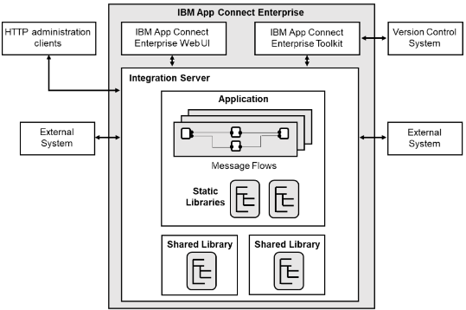
IBM Integration Bus Training
App Connect Enterprise –Integration Server Internals

Slide 22
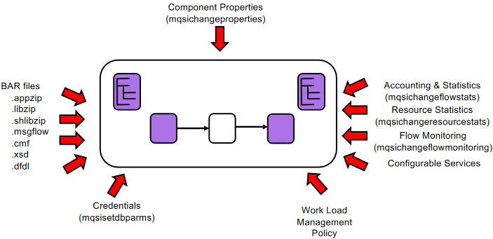
IBM Integration Bus Training
Current Stateful Configuration of an Integration Server

Slide 23
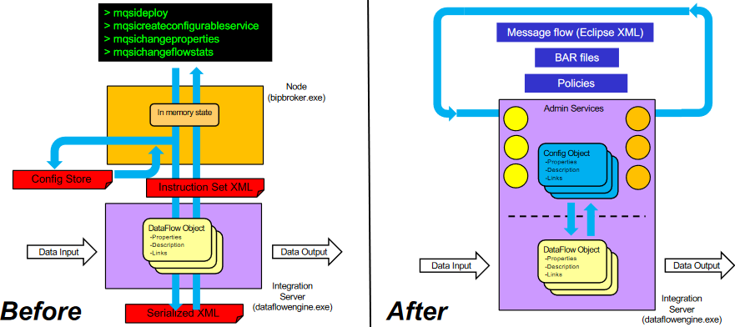
IBM Integration Bus Training
Architecture changes in App Connect Enterprise

Slide 24
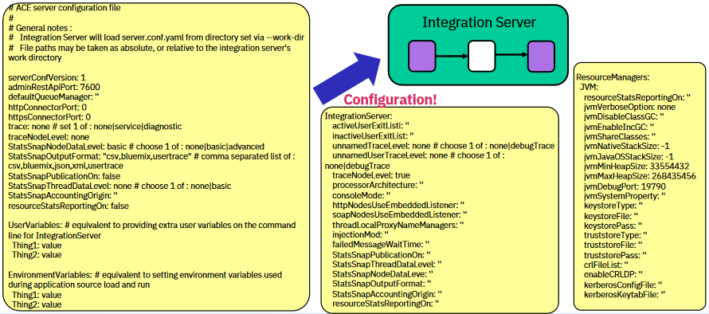
IBM Integration Bus Training
Welcome to your new friend -server.config.yaml

Slide 25
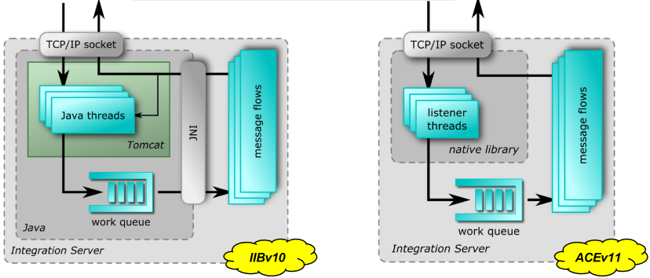
IBM Integration Bus Training
HTTP Listeners in IIBv10 and ACEv11

Slide 26
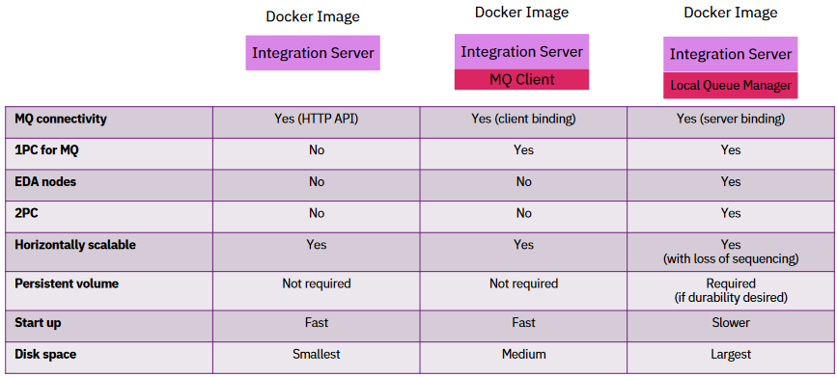
IBM Integration Bus Training
Docker Image Options for IIB/ACE and MQ

Slide 27
IBM Integration Bus Training
The Benefits of servers that don’t need a local queue manager
• SIZE: The size of the installation is dramatically reduced, and thereby the size of the Docker image. This reduces build times due to the reduced image creation time, and deployment times as a smaller image is transported out to the environments.
• MEMORY: The running container-based on the image uses significantly less memory usage as it has no processes associated with the MQ server. Cloud infrastructure used for container-based deployment is often charged based on memory rather than CPU so this can have a significant impact on running cost.
• START-UP: Start-up times of the containers are much faster as only one operating system process is started –that of the integration engine. This improves agility by reducing test cycle time, and improves resilience and elastic scalability by being able to introduce new runtimes into a cluster more rapidly.
• VOLUMES: MQ holds its message data on persistent volumes, and specific servers need access to specific volumes within the MQ topology. If IBM App Connect Enterprise has a local MQ server, it becomes locked into this topology. This makes it more complex to elastically add new servers to handle demand dynamically. For those using Kubernetes it may result in a StatefulSet rather than the more straightforward ReplicaSet. Once again, this makes it harder to take advantage of the cost benefits of elastic cloud infrastructure.

Slide 28
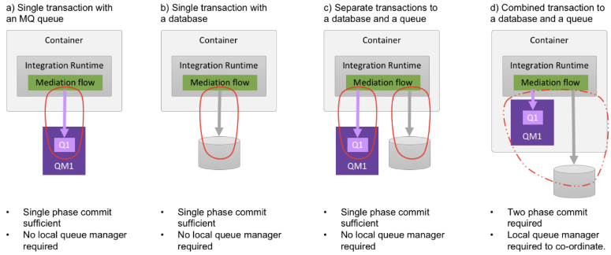
IBM Integration Bus Training
ACE Transactions and Queue Managers (1)

Slide 29
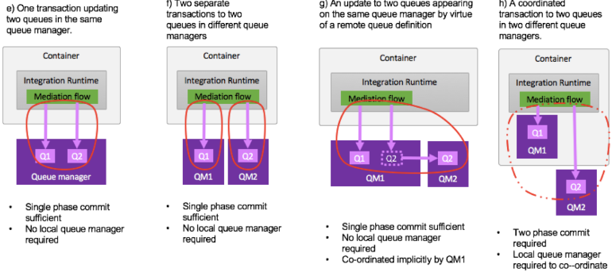
IBM Integration Bus Training
ACE Transactions and Queue Managers (2)

Slide 30
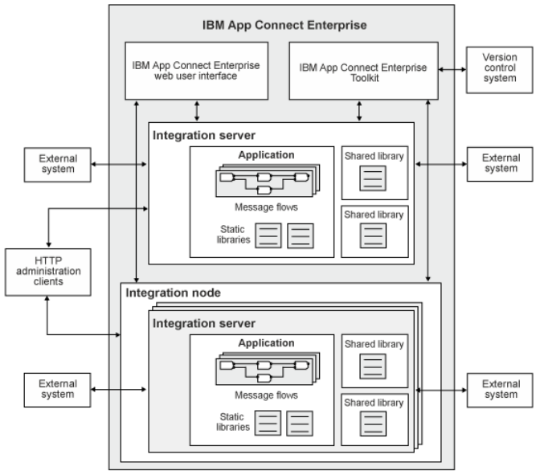
IBM Integration Bus Training
IBM App Connect Enterprise components Diagram - 01

Slide 31
IBM Integration Bus Training
IBM App Connect Enterprise components Diagram - 02

Slide 32
Systems ltd.
IBM ACE Training
IBM Integration Bus Training
Installation and configuration

